Slide 1

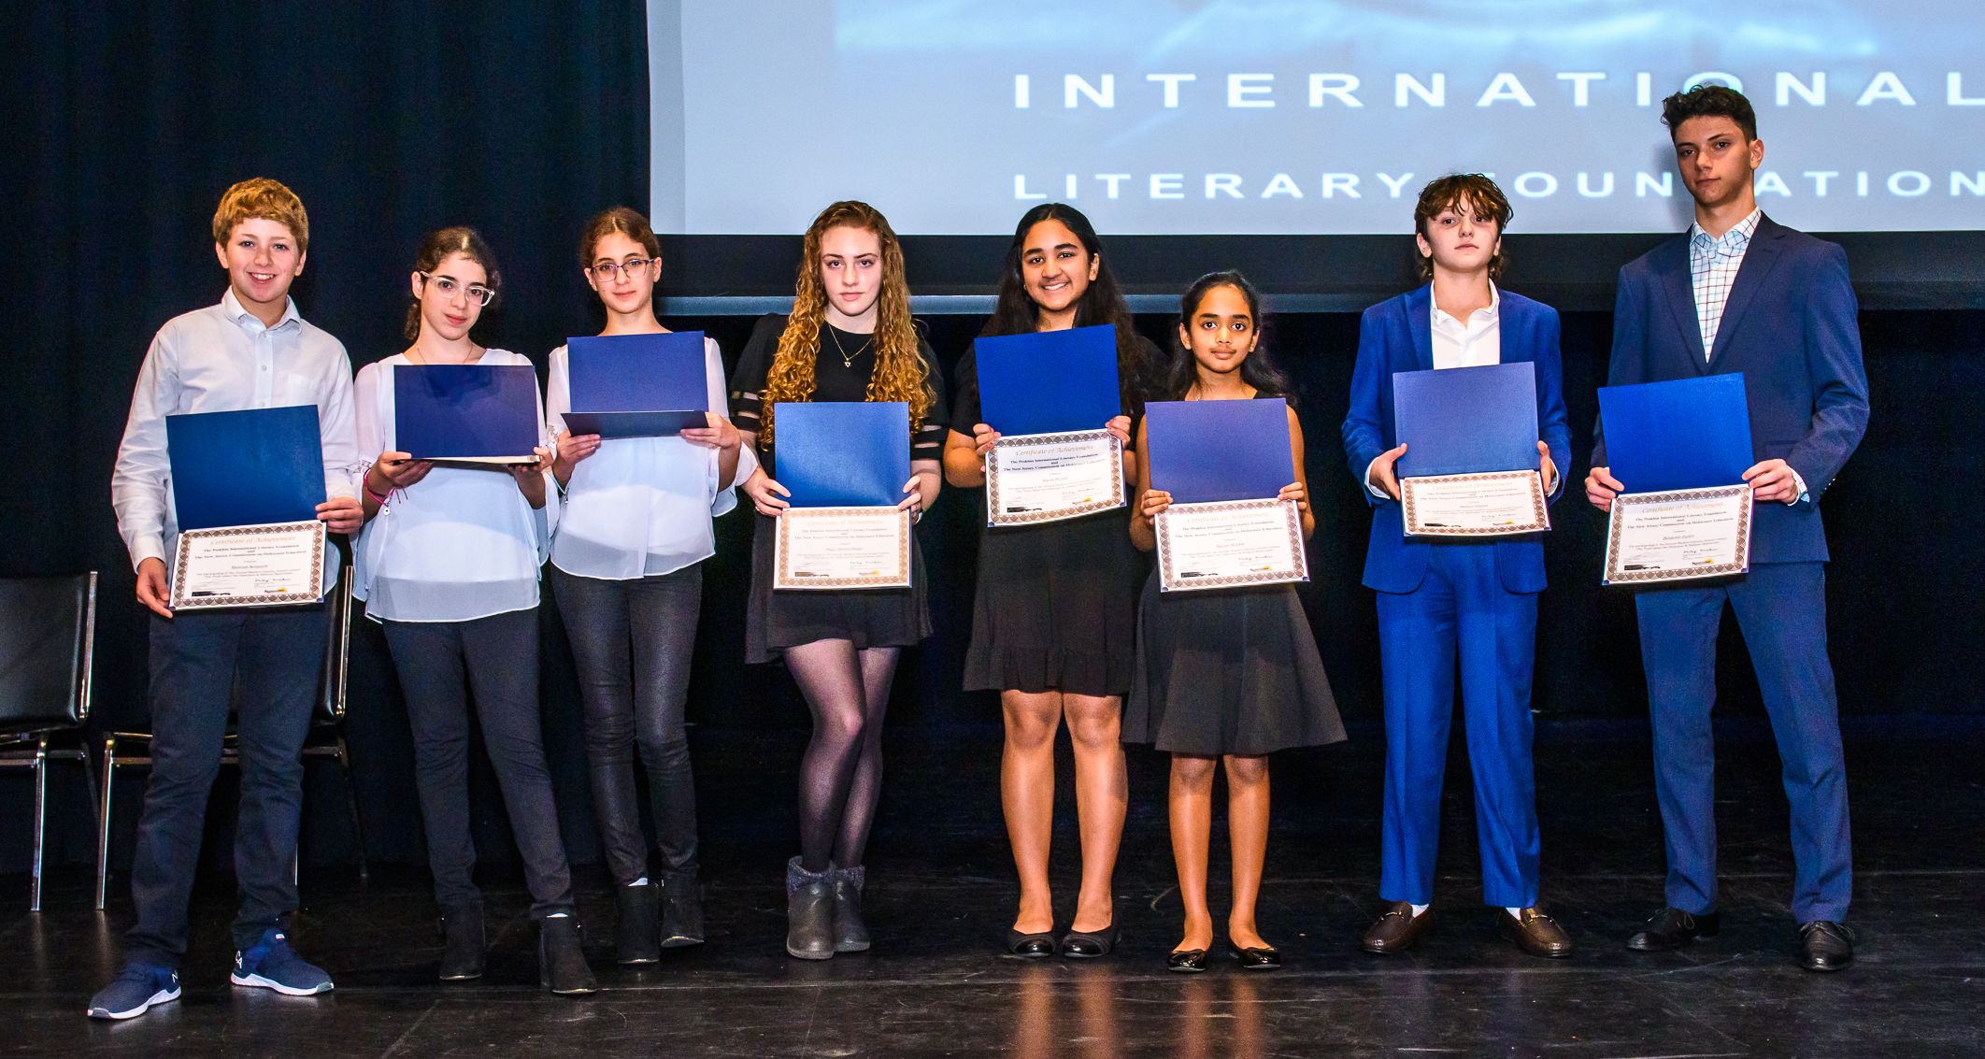
This award is dedicated to the memory of millions of victims who suffered and perished under the Nazi genocide, Stalinist repression and other genocides throughout world history.
19th Annual Student Literary
Award
Truth about the Holocaust and
Genocide
People of the world,
rise up for a minute
and awaken yourselves
and ask yourselves
have I done everything I could?
For my children, grandchildren
and great grandchildren
that they never forget and
always remember.
Lyudmila Prakhina
Sunday, February 8 , 2026 at 2:00PM
Fair Lawn Recreation Center
10-10 20th St, Fair Lawn, NJ 07410

Slide 2
Annual Student Award Ceremony 2026
We encourage Holocaust and Genocide survivors and families to write about personal experiences during those years in order to preserve their memories.
Recognize non-Jews who worked, at great risk to their personal safety, to save Jews. Many of those men and women paid for their heroic efforts with their lives and became known as the “Righteous Gentiles.”
We uphold values such as compassion, forgiveness and tolerance. We invite schools and universities to participate in the Annual Student Literary Award contest. Students learn about and preserve history through writing stories of survival, interviewing victims and their relatives, and creating unique photos and drawings, After all, young adults are the ones who need to carry these memories through to future generations.
We will continue to involve more high schools, and universities to submit writing, pieces of art, musical and drama performances, etc. to be presented in front of an audience during an awards ceremony.
For more information email –
ludmilaprakhina@msn.com
Dear Educator,
The Prakhin Foundation continues to reach out to young writers, artists, musicians, and students alike by involving high schools, and universities in teaching human values, such as compassion, awareness, and forgiveness. We continue to encourage students to submit their work reflecting the Holocaust, Stalinist Repression, and any genocide in efforts to preserve the memories of our ancestors and inspire awareness among our youth.
The time is coming to prepare students, teachers, speakers, and musical performers for the Annual Student Award Ceremony in January 2025. During every ceremony, we strive to focus on the very important mission to remember all the people suffering from difficult political situations, as fascism, antisemitism, and bandits which continue to grow everywhere around the world.
We will be very grateful if your students are willing to submit their composed works and partake in the Annual Student Award Ceremony.
All certificates and awards will be presented personally to students during the award ceremony. The top 3 submissions will receive monetary prizes and a trophy.
Please encourage your students to submit their works.
Ludmila Prakhina, president of the Prakhin Foundation
.

